Slide 1
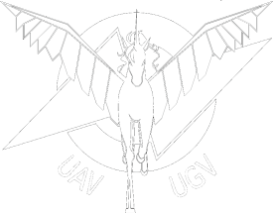
UGV Target Acquisition
Visually identify and track the target
Pass the target location to the path planning algorithm
Assumptions
Solid color spherical target
Only one target in area of operation
Static target
Notes:
Goal of the target acquisition system is to visually identify and track the target and find it’s GPS coordinates. These coordinates are then passed to the navigation system.

Slide 2
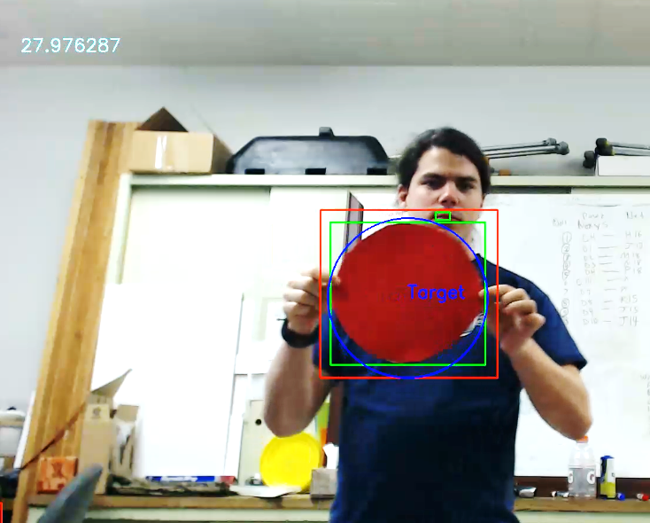
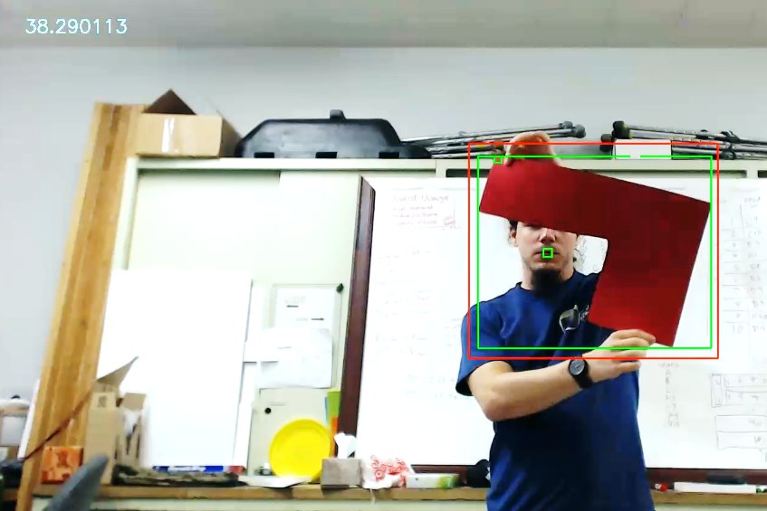
UGV Target Acquisition
Visual recognition and tracking of the target
Two stage optical object recognition using OpenCV2
The vision system can detect as many targets as are visibly discernable but will only track one target at a time
Primary target’s latitude and longitude are calculated using current robot state
Target Passed
Target Rejection

Slide 3
UGV Route Planning
UGV Path Planning
Find a navigable path to the target
Incorporate obstacle and collision avoidance capabilities
The pathing approach assumes a sparse, level, and contiguous area of operations
Path planning calculated using D* lite¹
LIDAR used for object detection using image processing inspired analysis
¹based on the work by Aaron Zampaglione

Slide 4
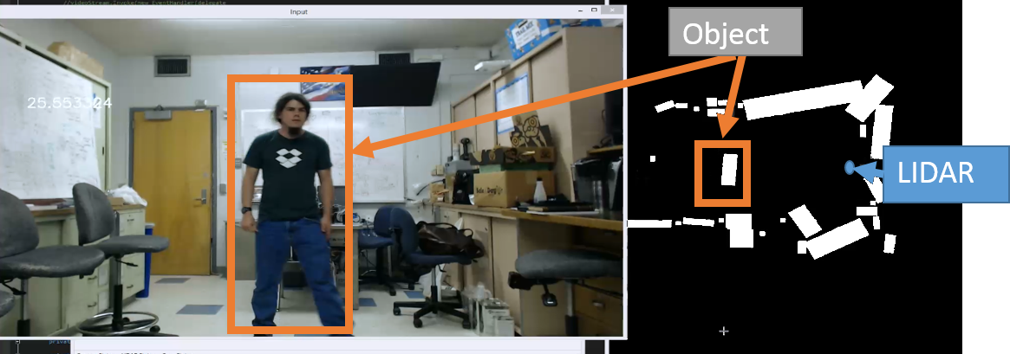
UGV Path Planning Algorithm Backup
LIDAR used for object detection using image processing inspired analysis
¹based on the work by Aaron Zampaglione
Notes:
The route planning system is designed to safely direct the UGV to the target’s location. The routing its self is done using a D*lite pathing algorithm that functions using a map that is populated using objects found by the LIDAR system.

Slide 5
UGV Optics Hardware Backup
Sensor | Property | Value
Camera |  | Logitech C902
 | Max Resolution | 1920x1080
 | Frame Rate | 60fps
 | Focus | 20 step auto focus
 | Communication | USB 2.0
LIDAR |  | Hokuyo UTM-30LX
 | Max Range | 30m
 | Scan range | 270°
 | Angular resolution | 0.25°
 | Communication | USB 2.0

